Slide 1

Evidence for
the Big Bang
Notes:
Slide notes
This presentation has been constructed using information drawn from a number of sources, the major one being Universe 101 Big Bang Theory http://map.gsfc.nasa.gov/universe/. It is highly recommended reading for physics teachers.

Slide 2

Review
List the four fundamental interactions of the universe.
Describe the volume, temperature and mass of the Singularity.
Why is the universe cooling as it expands?
‘An artist's concept of the first stars forming after the Big Bang’ by NASA,
http://science.nasa.gov/science-news/science-at-nasa/2008/22oct_missinggrbs/

Slide 3
Learning Intentions
The universe contains features including galaxies, stars and solar systems and the Big Bang theory can be used to explain the origin of the universe
identifying the evidence supporting the Big Bang theory, such as Edwin Hubble’s observations and the detection of microwave radiation
‘An artist's concept of the first stars forming after the Big Bang’ by NASA,
http://science.nasa.gov/science-news/science-at-nasa/2008/22oct_missinggrbs/

Slide 4
Success criteria
List three pieces of evidence that supports the Big Bang Theory
Explain how we have determined that the universe is expanding, using the Doppler Effect.
Explain how we have measured the amount of elements in the universe
Relate H and He to star formation
Describe microwave background radiation.
List three experiments that are collecting evidence for the Big Bang Theory.
‘An artist's concept of the first stars forming after the Big Bang’ by NASA,
http://science.nasa.gov/science-news/science-at-nasa/2008/22oct_missinggrbs/

Slide 5
Evidence for Big Bang theory
Big Bang theory is supported by a number of key scientific discoveries, including:
the expansion of the Universe,
the abundance of hydrogen and helium in the Universe, and
cosmic microwave background radiation.
‘An artist's concept of the first stars forming after the Big Bang’ by NASA,
http://science.nasa.gov/science-news/science-at-nasa/2008/22oct_missinggrbs/

Slide 6
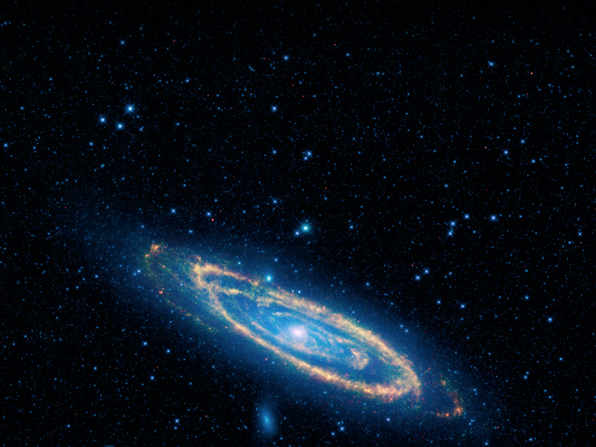
Discovery 1
The expansion of the Universe
‘Andromeda galaxy’, NASA/JPL-Caltech/UCLA
www.nasa.gov/mission_pages/WISE/multimedia/pia12832-c.html

Slide 7
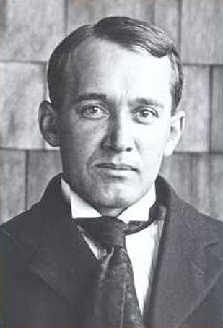
The expansion of the Universe
In 1912, Vesto Slipher observed that spectral lines in light from galaxies were shifted from their normal positions.
He explained these shifts by suggesting that galaxies were moving towards or away from us.
Credit: Lowell Observatory
http://www.lowell.edu/Research/library/paper/vm_slipher_pict.html
Notes:
Slide notes
Slipher discovered galactic redshifts. Hubble combined Slipher’s redshift data and his own measurements of the distances to galaxies to discover a rough proportionality of an object’s distance with its redshift.

Slide 8
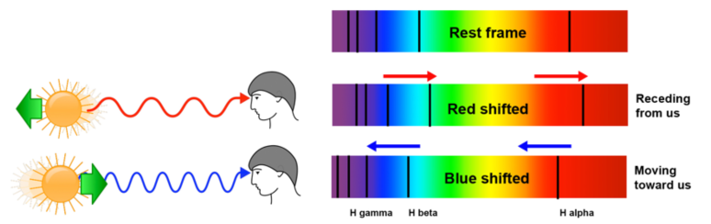
The Doppler effect
Spectral shifts can be explained using the Doppler effect.
Light from an object moving away from us appears to have a longer wavelength (it is shifted toward the red end of the spectrum).
Light from an object moving towards us appears to have a shorter wavelength (it is shifted towards the blue end of the spectrum).
Notes:
Slide notes
For more information on Doppler shift, see Cosmology 4: Shifted light.
Students’ attention may need to be drawn to the shift in positions of the dark absorption lines on the solar spectrum.
In astrophysics, redshift refers to a change in wavelength of light emitted by an object so that it appears ‘redder’. That is, visible light is shifted towards the red end of the visible spectrum. Astronomical objects also emit radiation outside the visible spectrum. The term ‘redshift’ is also used to refer to any increase in electromagnetic wavelength, with implied decrease in frequency and photon energy.

Slide 9
Velocities of galaxies
Slipher used measurements of spectral shifts to calculate velocities of galaxies.
He discovered that a few galaxies were approaching Earth, but most were moving away.
This information was later interpreted as evidence for the expansion of the Universe.
We now know that some objects within our local group of galaxies are blueshifted (approaching us), but most are redshifted (moving away). This is due to the Doppler effect.
Notes:
Slide notes
There are three types of spectral shift:
• Doppler shift is caused by relative motion between a source and an observer. Red and blue shifts observed from objects within the Local Group (which includes the Milky Way, Andromeda galaxy, Large and Small Magellanic clouds) are due to the Doppler effect.
• Cosmological redshift is caused by expansion of the Universe itself.
• Gravitational redshift is a shift in frequency when a photon moves to a lower energy state as it climbs out of a gravitational field. This presentation does not explore the concept of gravitational redshift.

Slide 10
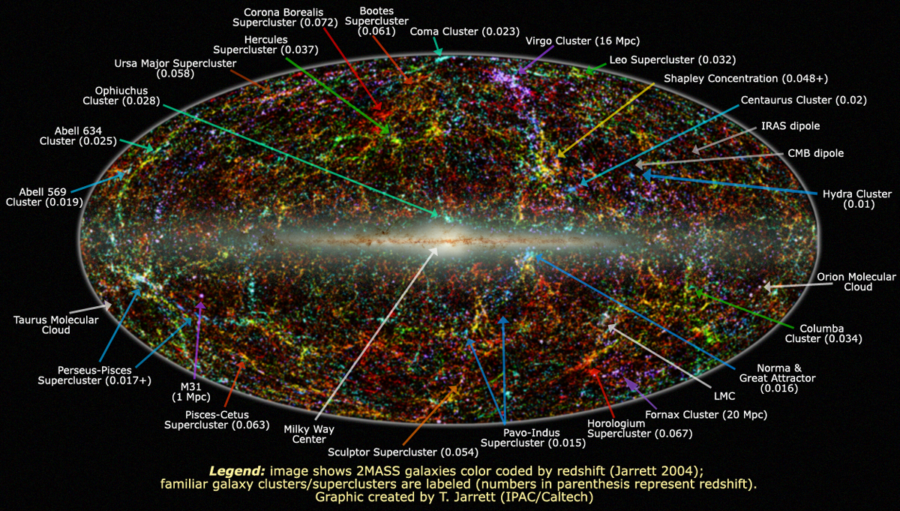
Cosmological redshift
However, beyond our local group, all galaxies are redshifted and their velocities are higher than the Doppler effect can explain.
These high velocities are due to cosmological redshift, which is caused by the expansion of the Universe itself.
Notes:
Slide notes
The image shows over 1.5 million of the brightest stars and galaxies in the nearby Universe detected by the Two Micron All Sky Survey (2MASS) in infrared light.
Across the centre are stars that lie in the plane of our own Milky Way Galaxy.
Away from the galactic plane, the vast majority of the dots are galaxies, color coded to indicate distance, with blue dots representing the nearest galaxies in the 2Mass survey, and red dots indicating the most distant survey galaxies.
Source: http://antwrp.gsfc.nasa.gov/apod/ap071211.html

Slide 11
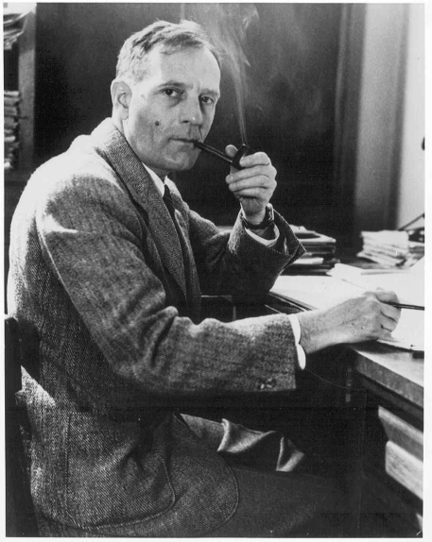
Edwin Hubble
Starting in 1924, Edwin Hubble devised a series of indicators to measure distances to galaxies.

Slide 12
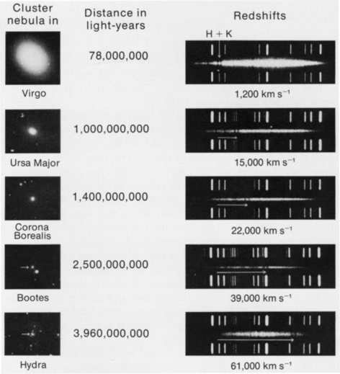
The spectra of galaxies
Hubble observed and recorded spectra of faint galaxies.
He compared them with spectra of laboratory standards and calculated their velocities.
Illustration from J Silk, The Big Bang, 2nd Ed., http://rst.gsfc.nasa.gov/Sect20/A9.html
Notes:
Slide notes
If you look closely, the H and K lines on the chart are shifting towards the red end of the spectrum as the distance increases.

Slide 13
Hubble's law
He plotted their distance against velocity and developed Hubble's Law, which states:
  The rate at which astronomical objects move apart from each other is proportional to their distance from each other.
This is expressed as v = H_{σ}D, where H_{σ} is the Hubble constant, D is the distance to a galaxy and v is its velocity.

Slide 14
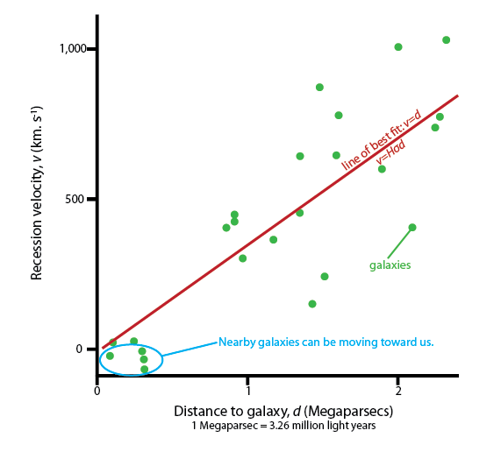
Hubble's plot of galaxy distance vs velocity

Slide 15
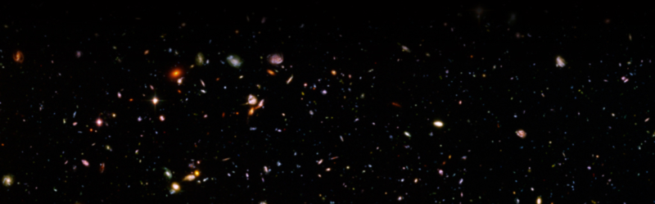
Conclusions from Hubble's law
Either:
Earth is at the centre of the Universe, or
the Universe is expanding.
Which explanation is most likely?
The Hubble ultra deep field image shows galaxies from an ancient era when the Universe was younger, denser and warmer.
Hubble ultra deep field, by NASA and ESA
http://hubblesite.org/newscenter/archive/releases/2004/07/image/a/warn/
Notes:
Slide notes
Answer: The second conclusion is more likely. According to the cosmological principle, the Universe has uniform composition and density in all directions. No one location in the Universe is privileged over any other. There is no ‘centre’ or ‘edge’ to the Universe.
A useful analogy is to compare the movement of galaxies to the movement of raisins in an expanding ball of bread dough. As the dough expands, raisins move away from one another. From the perspective of each raisin (galaxy), the remainder of the dough (the Universe) is the same in all directions. However, the analogy breaks down if students think about what happens near the outer edges of the dough rather than in the main bulk.
Hubble’s law is taken as evidence that the known Universe is expanding.

Slide 16
Discovery 2
The abundance of hydrogen and helium in the Universe

Slide 17
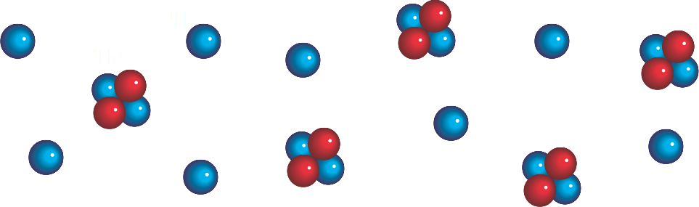
Nucleosynthesis
Big Bang theory explains that protons and neutrons fused together to form deuterium and helium in the first few minutes of the Universe.
The process where protons and neutrons combine to produce atomic nuclei is called nucleosynthesis.
Notes:
Slide notes
One second after the Big Bang, the Universe was at a temperature of about ten billion degrees Celsius and was filled with a sea of neutrons, protons, electrons, positrons, photons and neutrinos.
As the Universe cooled, neutrons decayed to form protons, electrons and neutrinos. The temperature of the Universe was still so high that electrons couldn’t combine with protons to form stable atoms.
By the time the Universe had cooled enough for nucleosynthesis to begin, the Big Bang theory predicts that the ratio of protons to neutrons was 7:1.

Slide 18
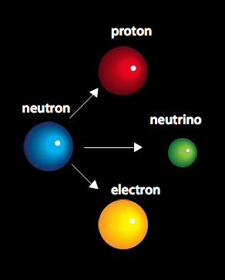
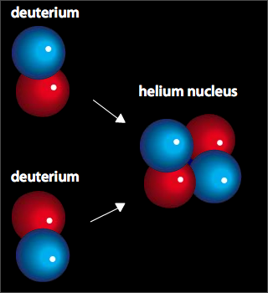
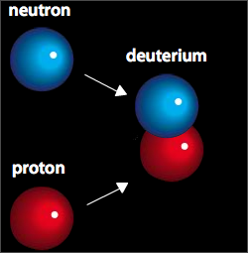
Neutrons
As the Universe cooled, neutrons:
decayed into protons and electrons, or
combined with protons to form deuterium.
Soon after, deuterium nuclei combined to form helium and small amounts of lithium.
Notes:
Slide notes
As the Universe continued to cool, protons began to combine with the remaining neutrons to form deuterium nuclei.
About three minutes after the Big Bang, most deuterium combined to form helium nuclei. Trace amounts of lithium were also formed at this time.
Big Bang theory predicts that the early Universe was made up of one helium nucleus (mass = 4) for every 12 hydrogen nuclei (protons, mass = 1), i.e. the ratio of the mass of helium to the total mass is 4:16 or 25%. From this, it was predicted that helium made up 25% of the mass of the early Universe.

Slide 19
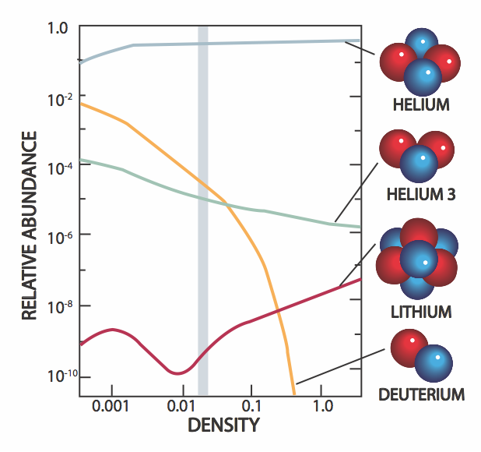
Abundance of hydrogen and helium
The predicted abundance of hydrogen and helium depends on the density of the early Universe.
Observations indicate that about 24% of the Universe is helium, produced shortly after the Big Bang.
The predicted amounts of deuterium, helium and lithium agree closely with observed amounts.
This is a major success for the Big Bang Theory.
Notes:
Slide notes
The graph shows the predicted abundance of deuterium, lithium and helium in the early Universe. It is evident that the yield of helium is relatively insensitive to the density of ordinary matter, above a certain threshold. Cosmologists expect about 24% of the ordinary matter in the Universe was helium produced in the Big Bang. This agrees closely with observations and is strong evidence to support the Big Bang Theory.

Slide 20
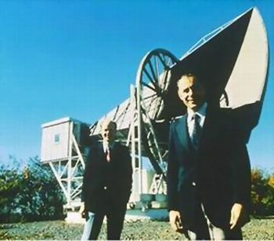
Discovery 3
Cosmic microwave background radiation

Slide 21
Cosmic microwave background radiation
The Universe became transparent to radiation about 370 000 years after the Big Bang.
Photons from this time still fill the Universe, but their wavelength has stretched as the Universe has expanded.
In 1965, radioastronomers Penzias and Wilson discovered a 1.9 mm microwave background radiation that evenly fills the observable Universe.
Properties of this radiation match predictions from Big Bang theory.
Notes:
Slide notes
The existence of cosmic microwave background radiation (CMBR) was first predicted by Ralph Alpher, Robert Herman and George Gamow in 1948, as part of their work on Big Bang nucleosynthesis.
Arno Penzias and Robert Wilson first detected CMBR as ‘noise’ in a radio antenna they were building at the Bell laboratories in New Jersey. They initially thought it was interference from New York city, but eventually recognised it as cosmic background radiation – remnant heat radiation from the Big Bang.
Today, the CMBR is very cold due to the expansion of the Universe - only 2.725 Kelvin above absolute zero.
CMBR fills the Universe and can be detected everywhere we look. Its temperature is uniform to within one part in a thousand.

Slide 22
The cosmological principle
Cosmic microwave background radiation is a good illustration of the cosmological principle.
It tells us that matter in the Universe is homogeneous (uniform density) and isotropic (the same in all directions).
It means that the Universe has no centre or edges - it is the same throughout.
Notes:
Slide notes
According to the cosmological principle, the Universe has uniform composition and density in all directions. From this, we assume that the same laws of physics that apply on Earth apply equally to all other parts of the Universe.

Slide 23
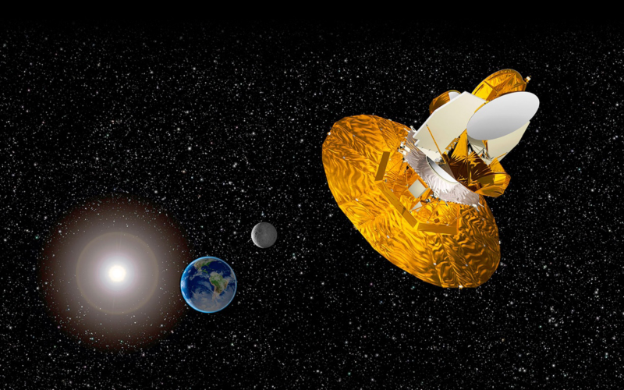
Wilkinson microwave anisotropy probe
However, small variations in the cosmic microwave background radiation have been discovered.
They were measured by the Wilkinson microwave anisotropy probe (WMAP) spacecraft, which was launched in June 2001.
Notes:
Slide notes
In 1992, the Cosmic Background Explorer (COBE) satellite was launched to study background radiation. It detected minute variations in the background radiation.
In 2001, the Wilkinson Microwave Anisotropy Probe (WMAP) was launched to measure variations (at the parts per million level) in the temperature of CMBR.
Cosmologists propose that variations in CMBR are evidence of variations in the density of matter in the early Universe that led to formation of galaxies and other large-scale structures.

Slide 24
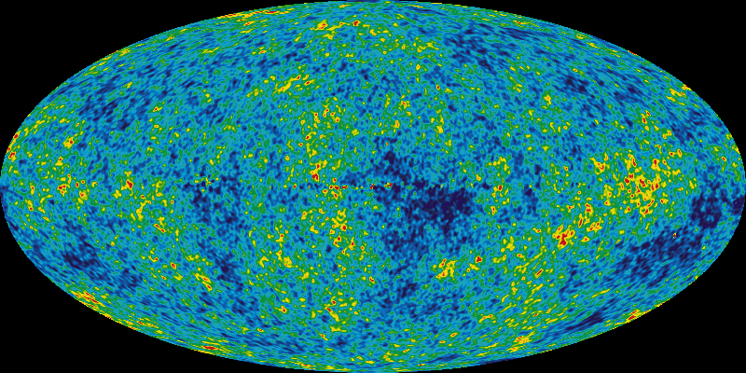
WMAP results
WMAP showed that CMBR is almost uniform (isotropic) in all directions. But at high resolution, there are small temperature variations (only a few thousandths of a Kelvin).
CMBR shows a distribution similar to that expected if a red-hot gas was blown up to the size of the Universe.
This evidence supports Big Bang theory.
5 year WMAP image
Red spots on the map are ‘warmer’ and blue spots are ‘cooler’.
Notes:
Slide notes
The image shows the WMAP five-year map of cosmic microwave background radiation. Colours indicate minute temperature variations in the background radiation – red spots are ‘warmer’ and blue spots are ‘cooler’.
credit: NASA/WMAP Science Team

Slide 25
The search for further evidence
Three major scientific projects are currently in the search for further evidence of the Big Bang.

Slide 26
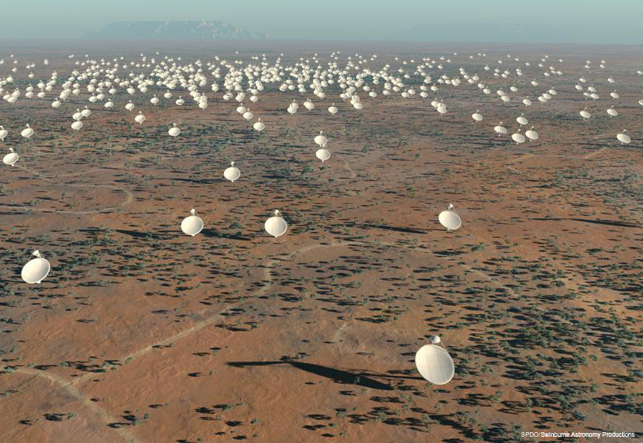
1. The Square Kilometre Array
The SKA is a radio telescope with collecting area of one square kilometre.
Its high resolution will allow astronomers to see further than any previous radio telescope.
It will be used to research questions in physics, cosmology and astrobiology.
The Murchison region of Western Australia is one of two possible locations for the SKA.

Slide 27
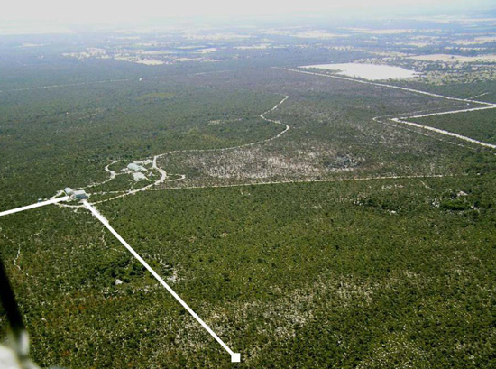
2. Gravitation wave observatories
Gravitational waves are predicted by Einstein's general theory of relativity, but none have yet been detected.
The Big Bang is believed to have created gravitational waves that still fill the Universe.
Gravitational wave detectors are interferometers with arms several kilometres long.
Gravitational wave observatories have been built in the USA (LIGO), Japan (TAMA) and Europe (VIRGO). Australia plans to build a full-scale detector (AIGO) at Gingin WA.

Slide 28
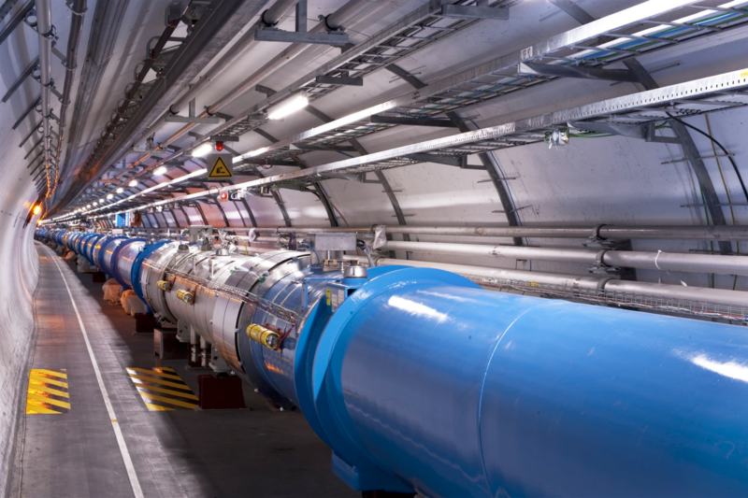
3. The Large Hadron Collider
The Large Hadron Collider is a gigantic particle accelerator, located near Geneva in Switzerland.
It collides beams of particles together at almost the speed of light to research conditions similar to those that existed in the Big Bang.
The results will provide information about the fundamental particles of matter and forces in nature.

Slide 29
Alternatives to Big Bang theory
The Big Bang theory is considered to be our most successful theory of cosmology because it explains most experimental observations.
Refinements to the theory are continually being made as observations are improved.
Mathematical theories, including string theory and supersymmetry, may one day offer a deeper understanding of the origin of the Universe, but today’s evidence for the Big Bang is very strong.
Notes:
Slide notes
There are other theories about the origin of the Universe, but they’re not explored in this presentation due to time constraints and because they aren’t required in the current syllabus.
Whilst Big Bang theory is considered to be our most successful theory of cosmology, two problems presented challenges to the standard theory:
The Flatness problem
The WMAP survey showed the geometry of the Universe to be almost flat. However, Big Bang cosmology predicts it to be curved.
The horizon problem
Distant regions of space in opposite directions of the sky are so far apart that they could never have been in contact under standard Big Bang expansion, because the time it takes light travel between them exceeds the age of the Universe. Yet the uniformity of the CMBR tells us that these regions must have been in contact with each other in the past.
A solution
Inflation theory, developed in the 1980s, provided a solution to these problems by proposing a period of exponential expansion of the Universe shortly after the Big Bang. By including this inflationary period, the early Big Bang spherical surface would expand to stretch the initial curvature of the Universe close to flatness. It also explains why regions of space that are now so distant were once much closer together.

Slide 30
Success criteria
List three pieces of evidence that supports the Big Bang Theory
Explain how we have determined that the universe is expanding, using the Doppler Effect.
Explain how we have measured the amount of elements in the universe
Relate H and He to star formation
Describe microwave background radiation.
List three experiments that are collecting evidence for the Big Bang Theory.
‘An artist's concept of the first stars forming after the Big Bang’ by NASA,
http://science.nasa.gov/science-news/science-at-nasa/2008/22oct_missinggrbs/

Slide 31
© 2011 The University of Western Australia
ast0705, v1.0
for conditions of use see spice.wa.edu.au/usage

